Slide 1
Utah Division of Water Rights
Updates
Water Use Program
Water Users Workshop – March 2017
James Greer, P.E.
Assistant State Engineer – Technical Services
June 21, 2004

Slide 2
What is the Water Use Program?
USGS
Utah Division of Water Rights
Utah Division of Water Resources
Utah Division of Drinking Water

Slide 3
73-5-8 Reports by users to engineer. Every person using water from any river system or water source, when requested by the state engineer, shall within 30 days after such request report.

Slide 4
Water Use Data is Used for:
USGS studies
Water Resources Planning Programs and Efforts
Water Rights Water management policy development
State financial assistance programs
Assessment of water supply and water use.
Water Rights Proof processing
Systems to evaluate the efficiency of their own systems

Slide 5
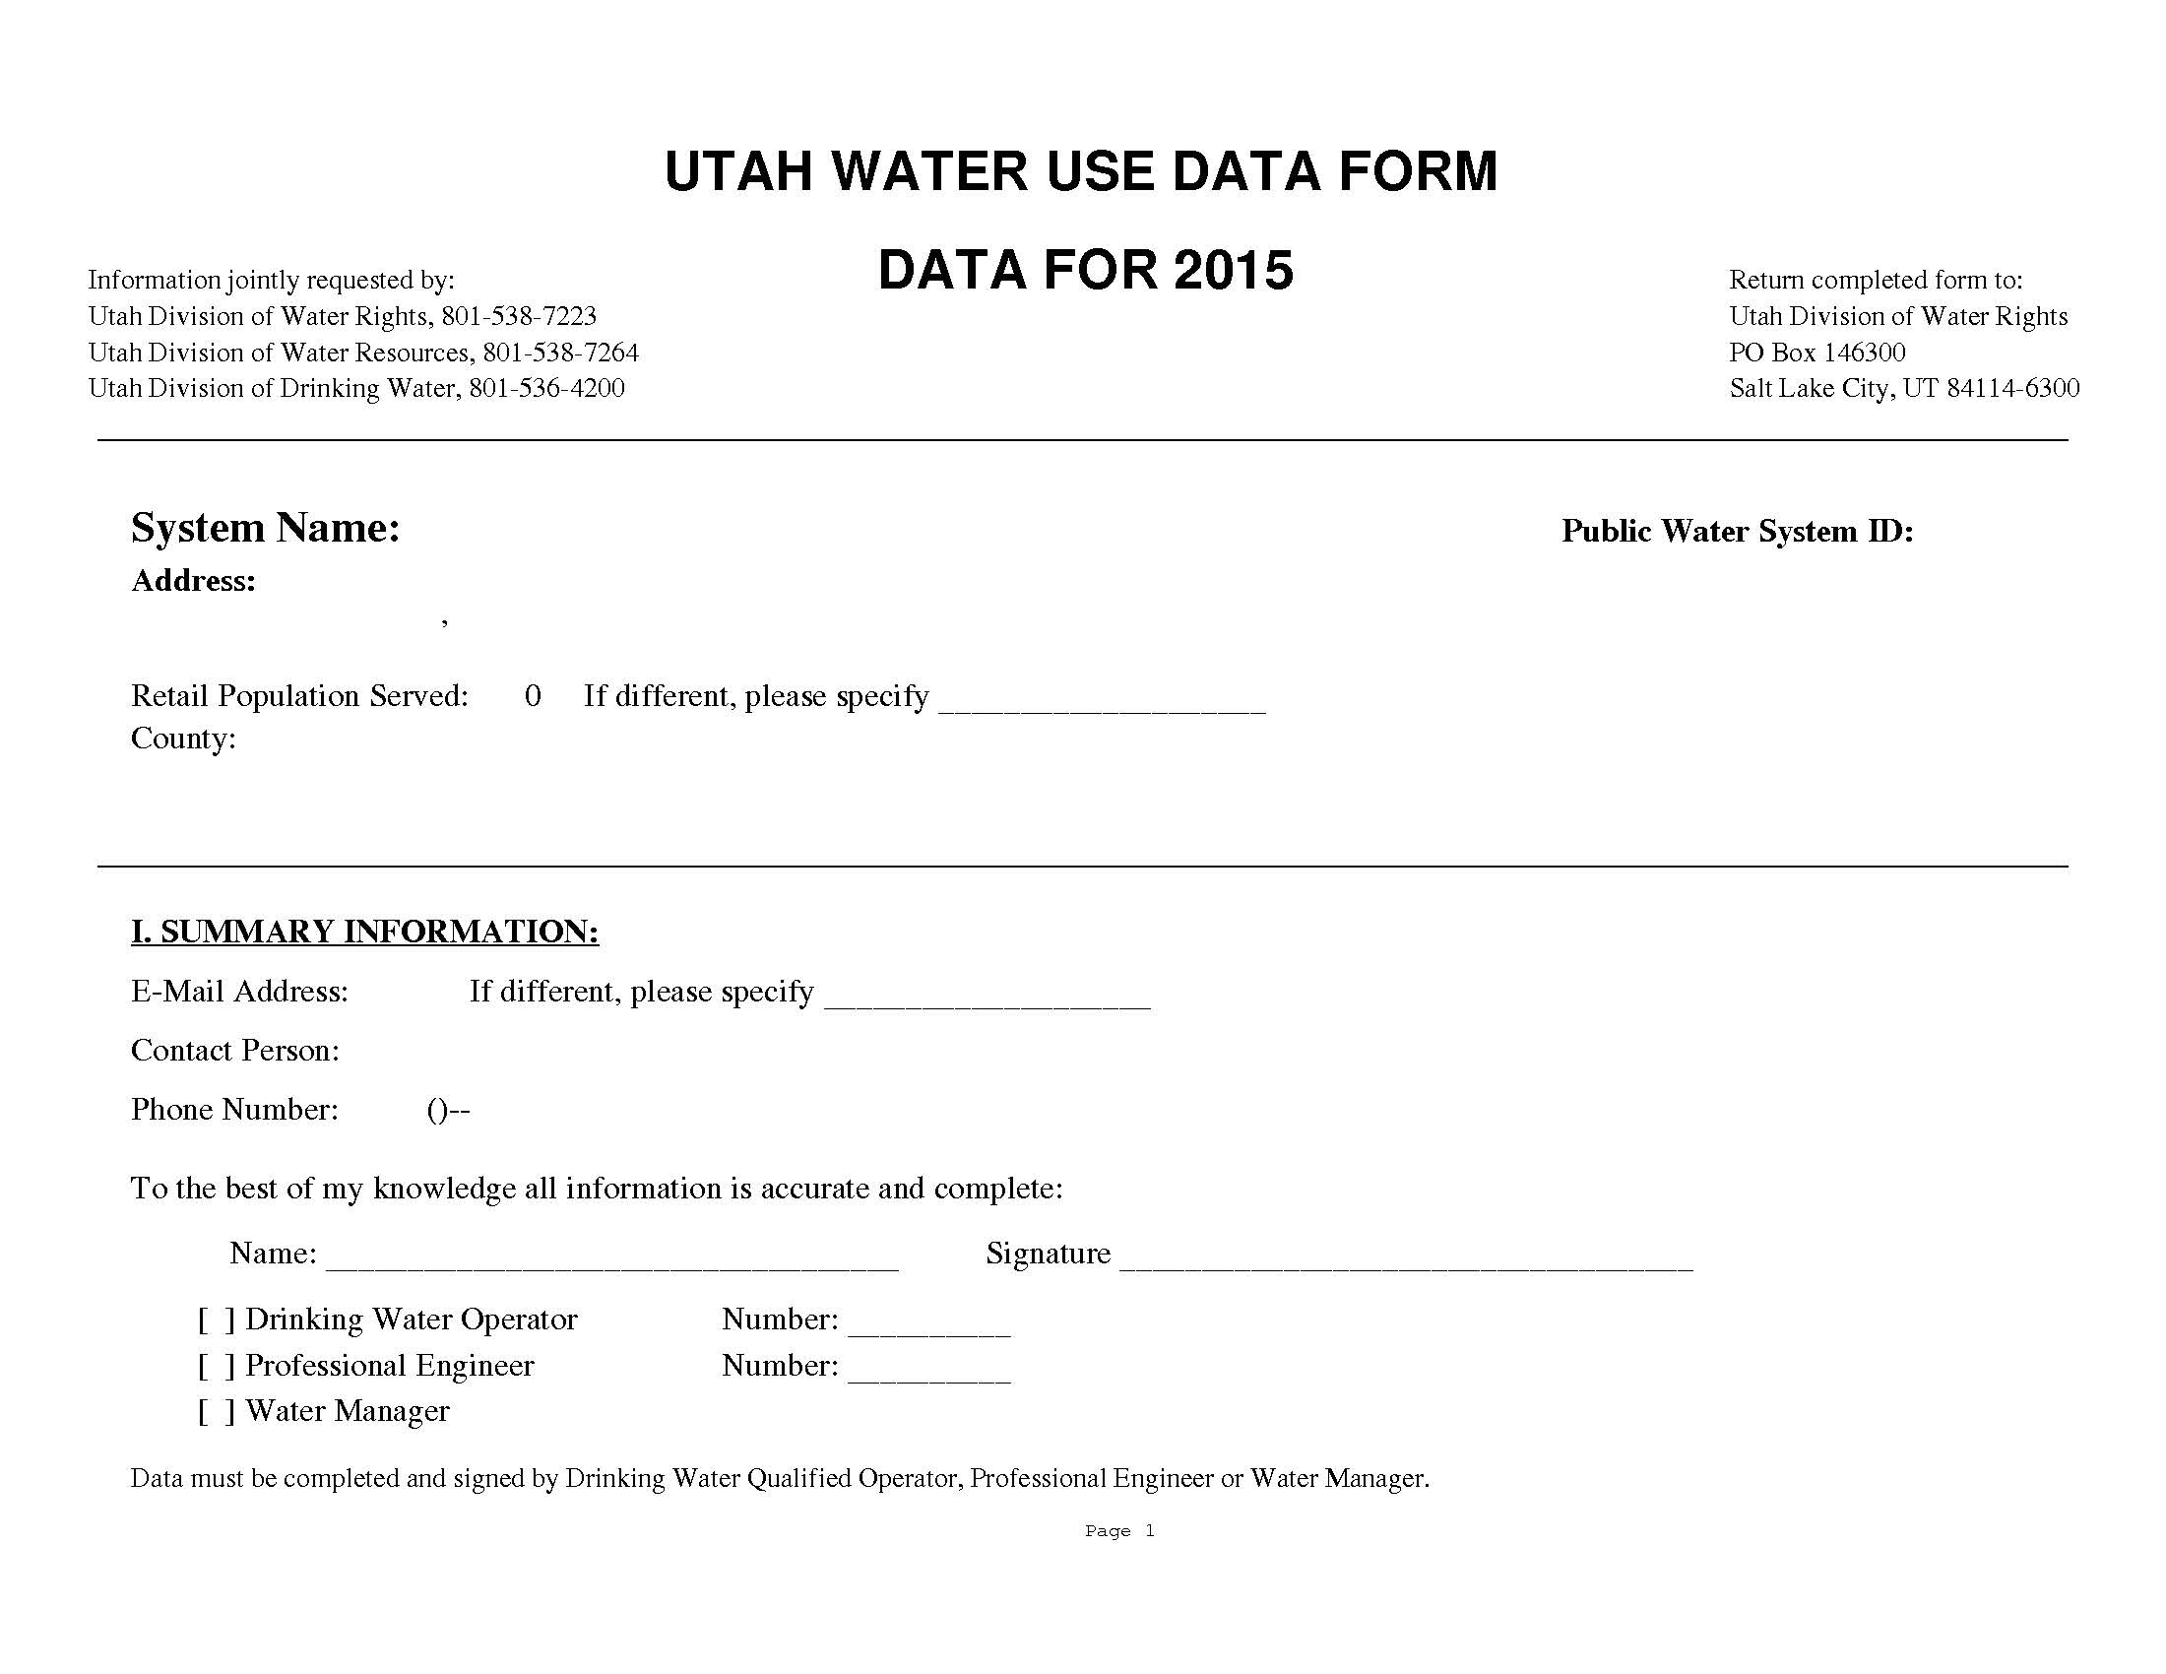
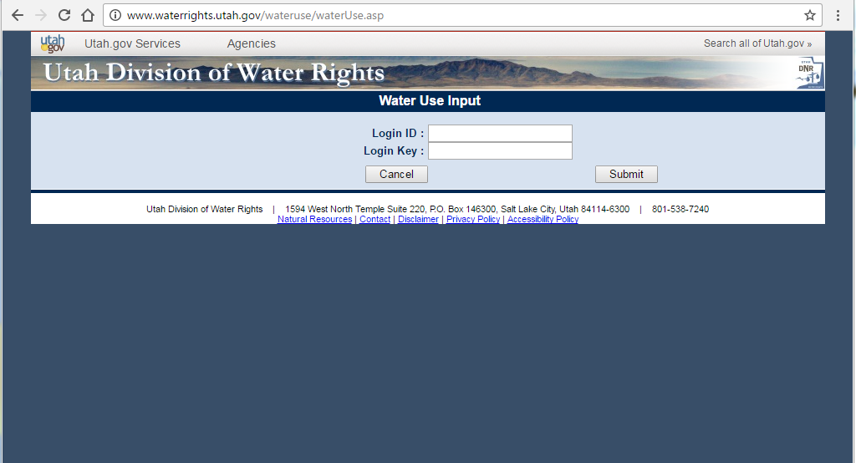
How is the water use data collected?
Annual Survey Paper / Electronic

Slide 7
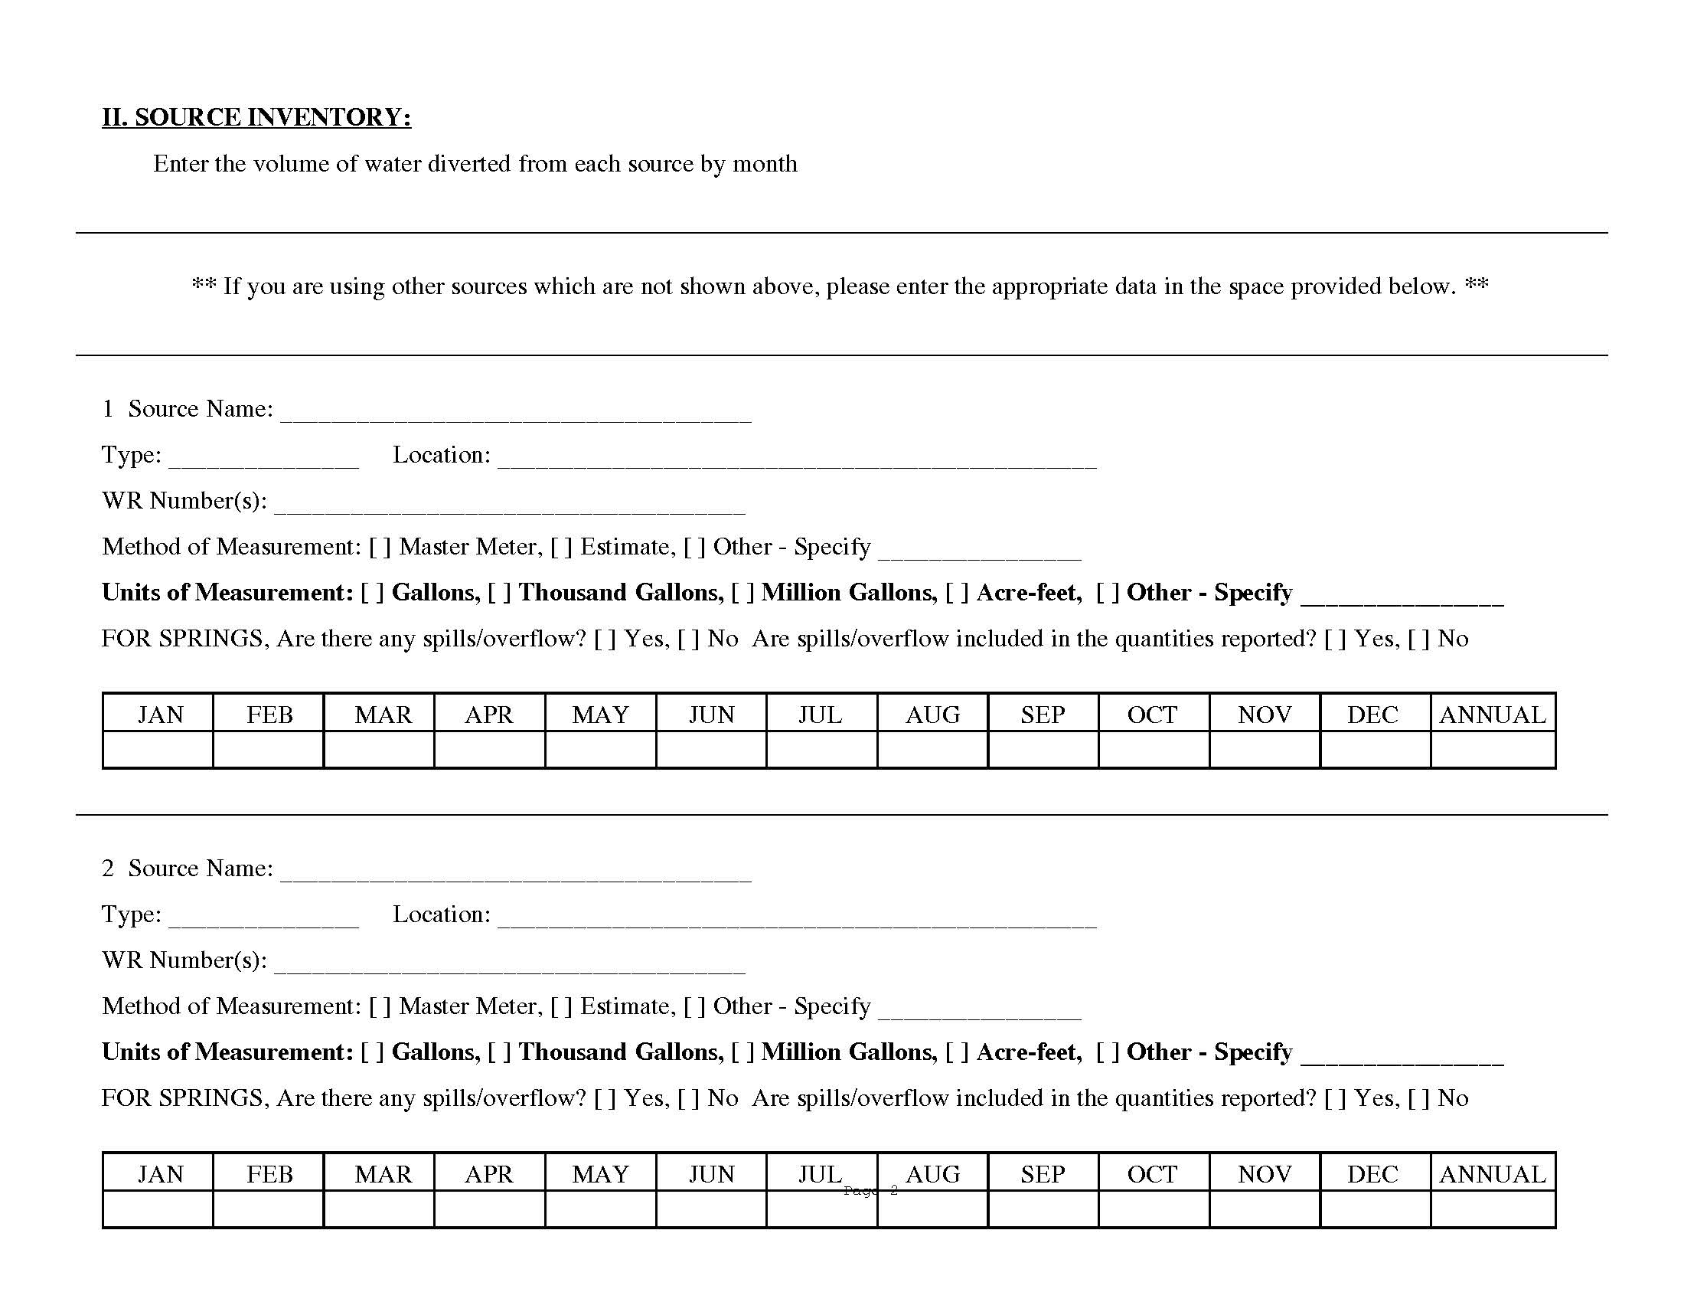

Slide 8
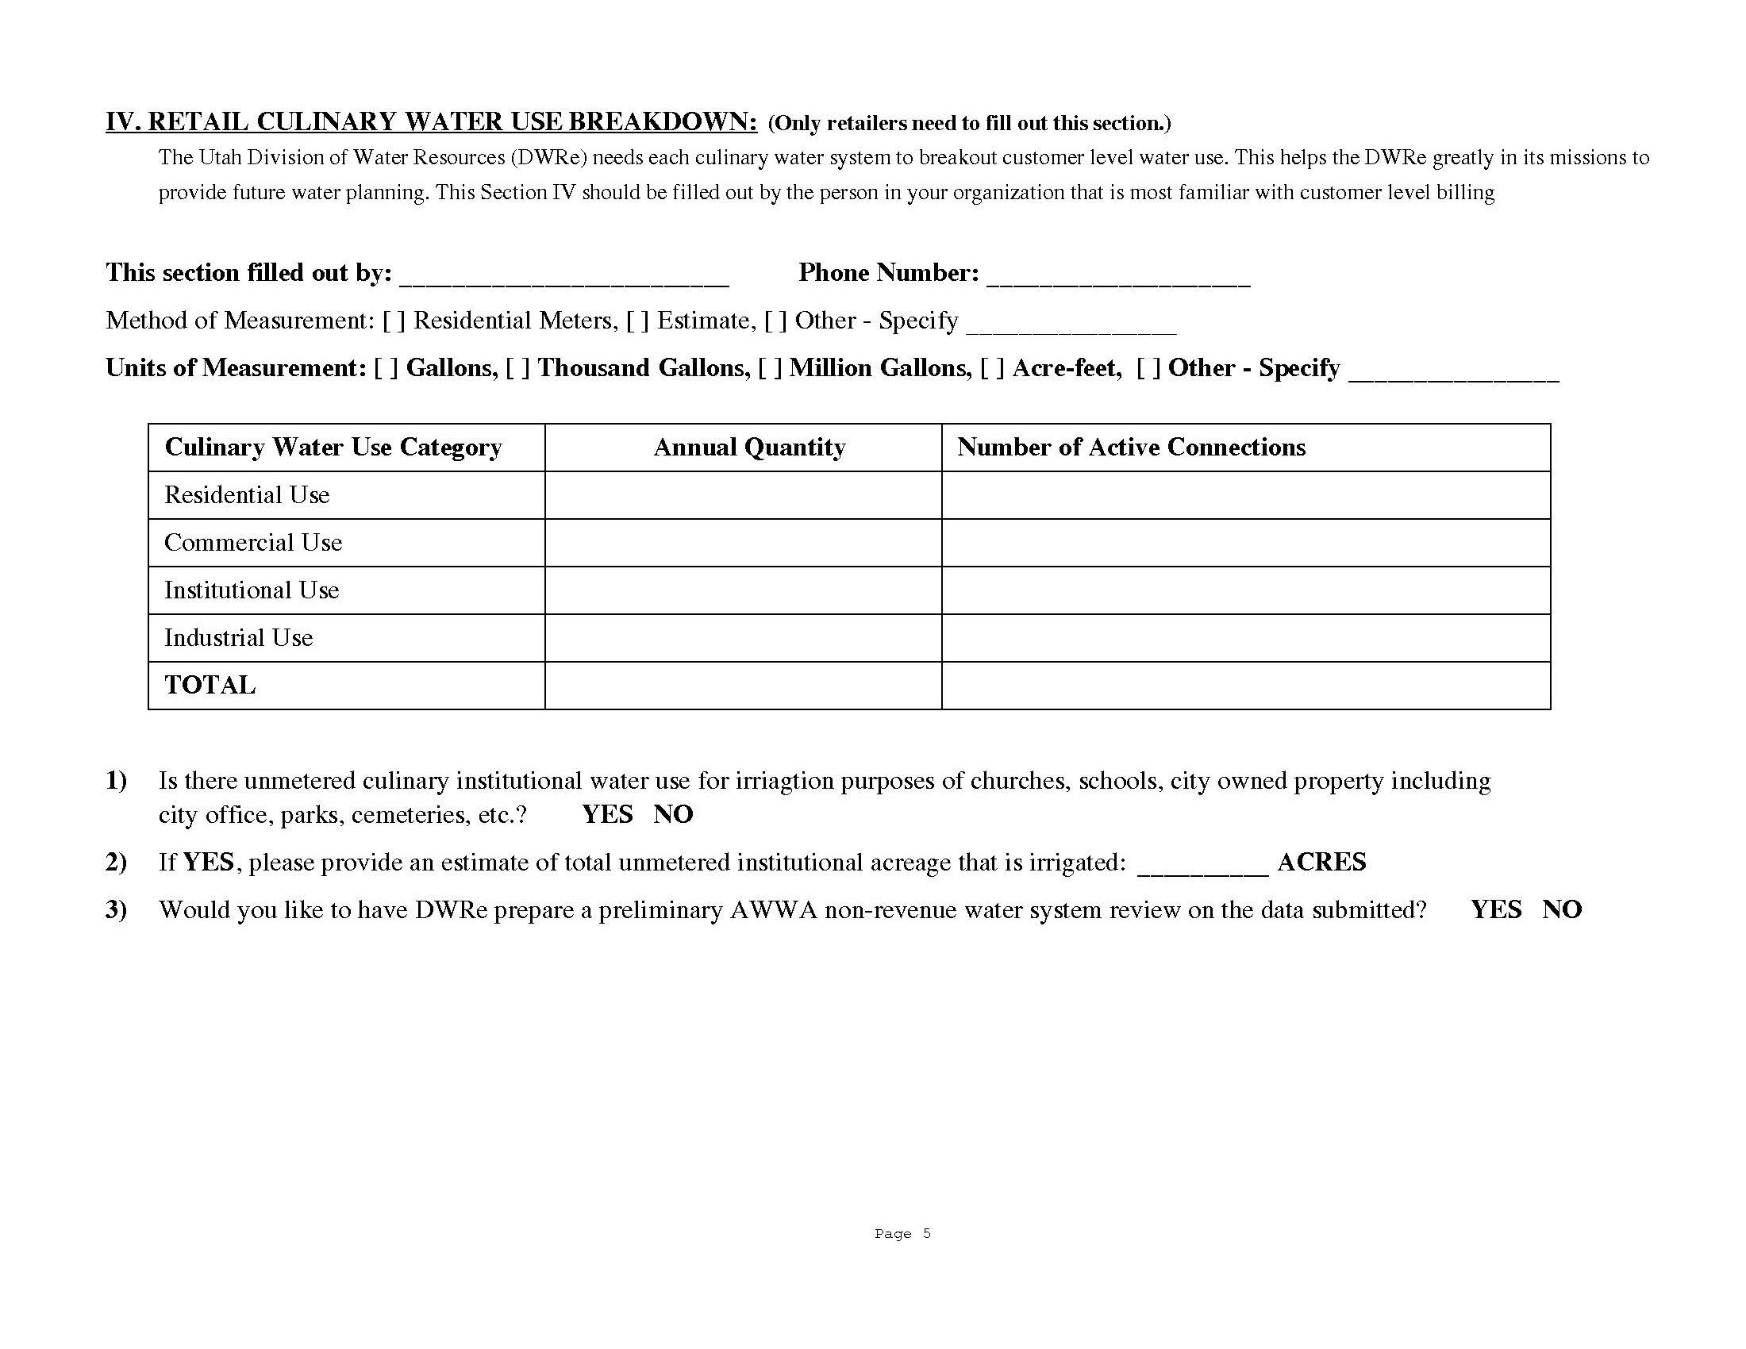

Slide 9
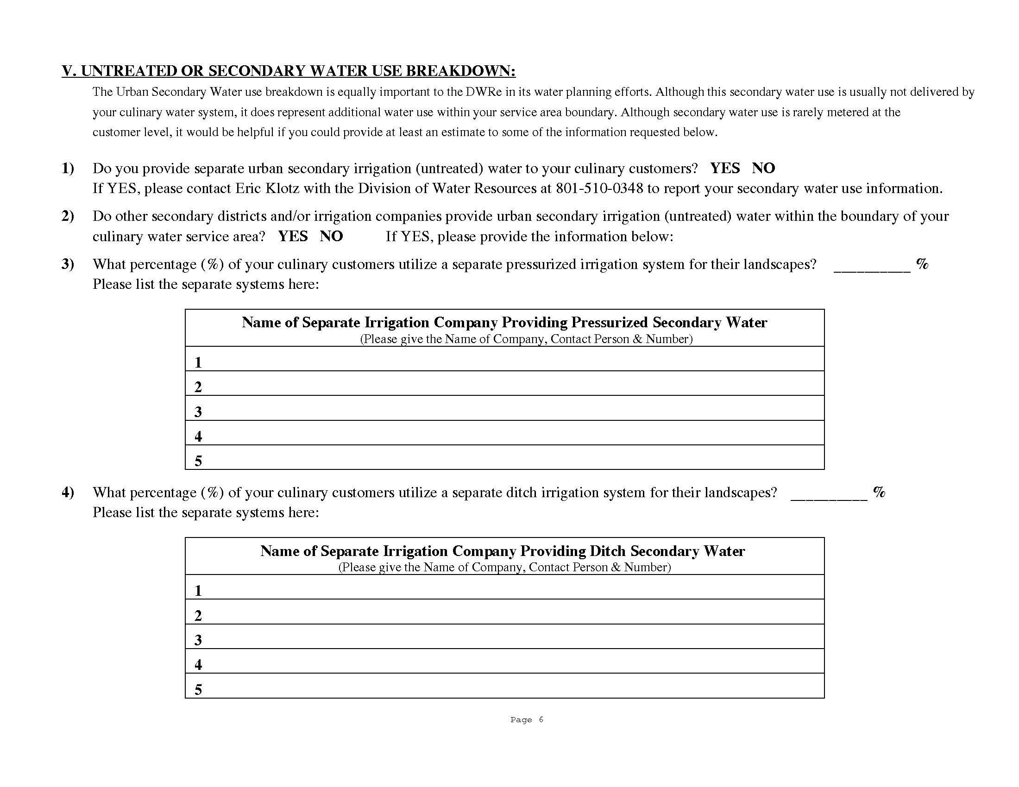

Slide 10
H.B. 305 – 2016 Legislative Session
Water Rights and Resources Amendments
Rep Briscoe, Sen Dayton
Deals With The Accuracy Of Water Use Data
Requires Certified Operator Or Professional Engineer To Verify Accuracy Of Submitted Water Data
Provides New Funding
Required To Draft Administrative Rule

Slide 11
Rule R655-17. Water Use Data Reporting and Verification.
4.3 If A Public Water Supplier Does Not Return The Water Use Data Form Or Knowingly Reports Inaccurate Data The System Will Be Reported To The Division Of Drinking Water
5.2 To facilitate the collection of water use data, the state engineer may require a water user install telemetry equipment on any measurement required under 73-5-4 in circumstances where conflicts among water users has been demonstrated.

Slide 12
Drinking Water Rule Changes
R309-105-15. Report Submittal.
(1) A public water system shall submit water use data if required by a state agency and shall verify the accuracy of the data by including a certification by a certified operator or a professional engineer performing the duties of a certified operator.
R309-400-12. Reporting and Record Maintenance Issues.
(3) Annual and Other Reports:
(a) A public water system that fails to submit water use data required by a state agency or fails to verify the accuracy of the data by including a certification by a certified operator or a professional engineer performing the duties of a certified operator shall be assessed 50 points.

Slide 13
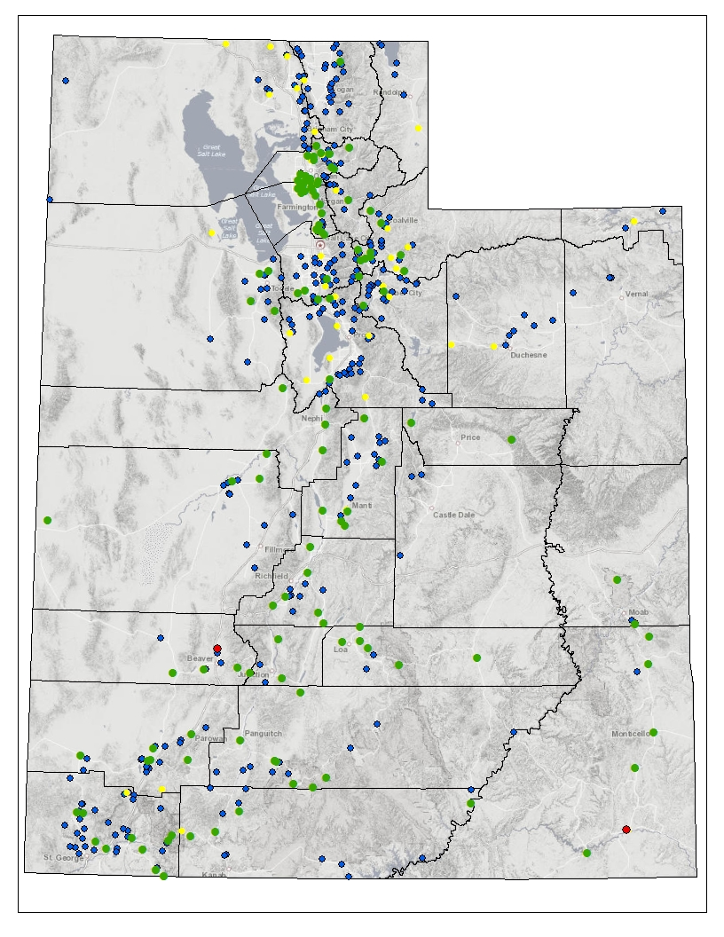
Public Water Suppliers
Water Use Data
Systems Visited
Systems Reported
Systems Not Reported
Systems Unwilling to Report
Notes:
Interior page
Headline and body copy left justified
This background should be used for all interior pages

Slide 14
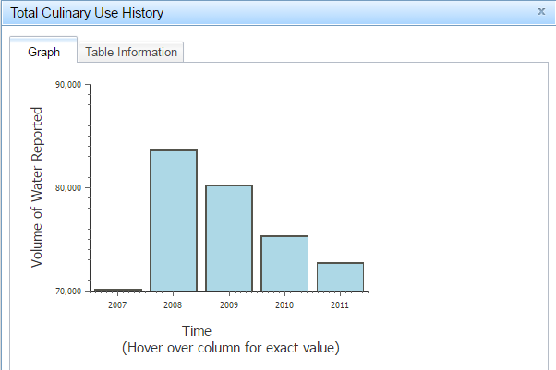
New Online Reporting System

Slide 15
Think Big!
Eric K. Klotz, P.E.
Water Conservation and Education Section Manager
Utah Division of Water Resources
ericklotz@utah.gov
James Greer, P.E.
Assistant State Engineer
Utah Division of Water Rights
jamesgreer@utah.gov

